Slide 1
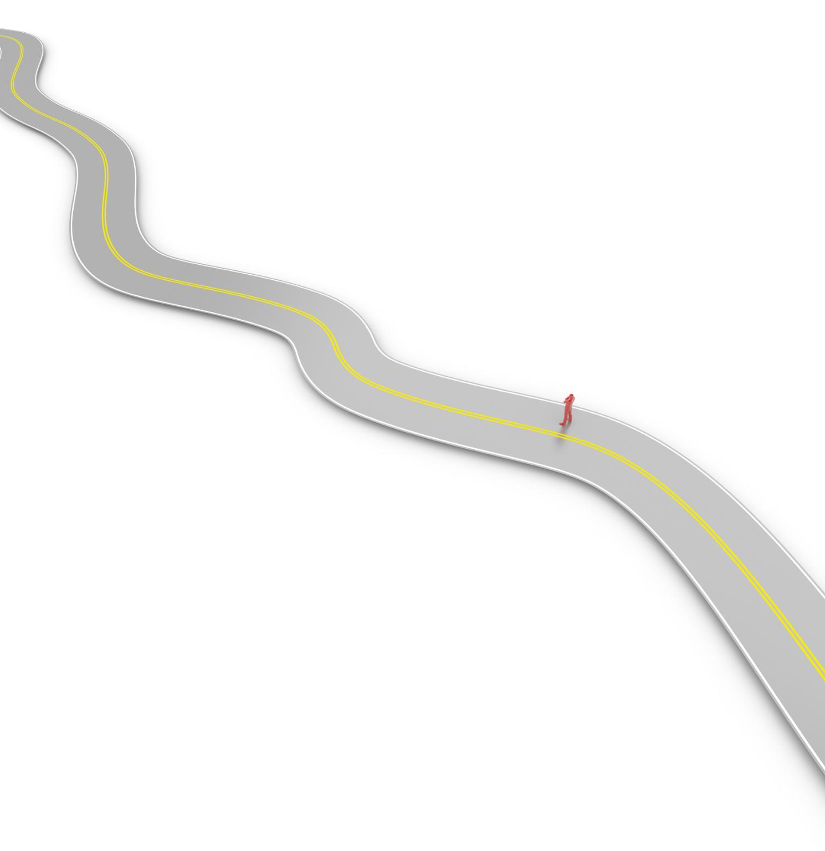
FY2025 Goals Overview
Wajahath Quraishi
Notes:
AI-generated content may be incorrect. --- Welcome to our presentation on the FY2025 goals that focus on uplifting our organization, driving quality outcomes, and delivering exceptional client experiences. We will outline our key objectives and the processes that will help us track our progress throughout the fiscal year.

Slide 2
FY25 –Organization Goals
Goal 1: Uplifting Our Organization
This theme focuses on strategies to enhance our internal culture and employee engagement within the organization.
Goal 2: Driving Quality Outcomes
We will discuss methods to improve the quality of our services and the impact on client satisfaction.
Goal 3: Exceptional Client Experiences
This theme revolves around creating memorable experiences for our clients through tailored services and support.
Notes:
Today's agenda will cover three main themes: Uplifting our organization, Driving quality outcomes that matter for our clients, and Delivering exceptional client experiences. We will break down each theme into specific goals and processes to enhance our operations.

Slide 3
Quick Glance at My Goal settings
Goal 1: Uplifting Our Organization
As a Delivery Manager for AI Workbench and AIQ, by the end of Q3 FY25,
Work towards process improvement targeting for a mature change management framework for Workbench deliverables.
Collaborate with cross-functional and GTK operations to facilitate efficient CAB process and other operational support item
Contribute towards continuous improvement through reviews & feedback to foster a culture of striving for excellence.
Goal 2: Driving Quality Outcomes
Improve GitHub Standardization and Hygiene:
As a Delivery Manager for AI Workbench, by the end of Q2 FY25,
Develop and implement in-house custom tools and utilities leveraging GitHub API and/or GraphQL to access GitHub repos
GitHub standardization and reporting on overall GH hygiene and GitHub usage and ease of use for the team
Ensure adherence to best practices, provide feedback loop through GH hygiene reports to identify non-compliance and non-adherence
.
Goal 3: Exceptional Client Experiences
Automation : By the end of Q3 FY25,
Develop and implement an automation tool to build the release notes markdown file for a current release with a single click.
Using python with GitHub API and GraphQL, extract and build the release notes based on settings in a configuration file
Automate the tagging and creating release for GitHub Repositories using a script based on configuration values
Notes:
Today's agenda will cover three main themes: Uplifting our organization, Driving quality outcomes that matter for our clients, and Delivering exceptional client experiences. We will break down each theme into specific goals and processes to enhance our operations.

Slide 4
Goal 1: Uplifting Our Organization
As a Delivery Manager for AI Workbench and AIQ, by the end of Q3 FY25,
Work towards process development and implement a mature change management framework for Workbench deliverables
Collaborate with cross-functional and GTK operations to facilitate efficient CAB process and other operational support item
Contribute towards continuous improvement through quarterly review & feedback to foster a culture of striving for excellence
Notes:
Today's agenda will cover three main themes: Uplifting our organization, Driving quality outcomes that matter for our clients, and Delivering exceptional client experiences. We will break down each theme into specific goals and processes to enhance our operations.

Slide 5

Goal 1: Uplifting Our Organization
Specifics
Evolving Work Practices /Communication
Being globally dispersed teams, we want to evolve our work practices on using collaboration tools, communication flow as per the best practices guidelines. This will help enhance efficiency, uniformity and seamless communication across global teams
Change Management Processes
As a Delivery Manager, follow the guidelines provided by GTK and work closely with the SME’s for Change Management, CAB and other processes and ensure adherence and continuous process improvement for effective change management
Partnering with GTK
Wherever applicable as a Delivery Manager, work closely with GTK team on providing the needed support and collaboration to facilitate efficient Operational Model and operation support processes.
Creating a supportive environment is essential for fostering personal and professional growth within the organization.
Notes:
Our first goal theme focuses on evolving our work, our teams, and ourselves. This involves developing processes that facilitate change management and continuous improvement. The goal is to create a supportive environment that fosters growth and collaboration.

Slide 6

Measure Progress: Review & Feedback
Quarterly Review on progress
Completed
Change Management & CAB Training - Completed
Marketplace Ticket creation process – Completed
APM tool : Setting up New application and updated releases in APM tool - Completed
On going / In Progress :
The actual execution of the CAB and Release deployment(s) are yet to kickoff - Pending
Approx ~ 40% Complete Planned Target : Q3 2025
Notes:
We will implement quarterly review sessions to foster a culture of excellence and continuous improvement. This will uplift team members and ensure we remain committed to meeting or exceeding customer expectations through sustained development.

Slide 7
Goal 2: Driving Quality Outcomes
Improve GitHub Standardization and Hygiene:
As a Delivery Manager for AI Workbench, by the end of Q2 FY25,
Develop and implement custom tools leveraging GitHub API and/or GraphQL to access GitHub repos
GitHub standardization and reporting on overall GH hygiene and GH usage and ease of use for team
Ensure adherence to best practices, enabled feedback loop thru GH hygiene reports,
=> Helps identify non-compliance and non-adherence
.
Notes:
Today's agenda will cover three main themes: Uplifting our organization, Driving quality outcomes that matter for our clients, and Delivering exceptional client experiences. We will break down each theme into specific goals and processes to enhance our operations.

Slide 8

Goal 2: Driving Quality Outcomes
Standardizing GitHub Usage
Standardizing GitHub usage across teams ensures consistency in workflows and improves overall project tracking and improved GH hygiene and usage.
Custom Tools Development
Developing custom tools using APIs allows teams to tailor solutions that meet specific client needs and drive quality results.
Notes:
The second goal theme focuses on ensuring quality outcomes for our clients. We aim to standardize GitHub usage and enhance collaboration across teams through the development of custom tools and utilities using GitHub API and GraphQL.

Slide 9
Improving GitHub Standardization
Custom Tools Development
We aim to develop in-house custom tools that will integrate with GitHub API to streamline workflows.
Standardization Across Teams
Implementing these tools will help ensure standardization in GitHub usage across different teams and projects.
Adherence to Best Practices
By standardizing usage, we ensure adherence to best practices which leads to more efficient workflows.
Notes:
By the end of Q2 FY25, we will develop and implement in-house custom tools that leverage GitHub API to standardize usage across teams. This ensures adherence to best practices and promotes an efficient workflow.

Slide 10

GitHub Hygiene Reports
Feedback Loop Implementation
We will create a feedback loop using hygiene reports to pinpoint areas of non-compliance effectively.
Identifying Non-Compliance
Regular hygiene reports will help identify instances of non-compliance and ensure the team adheres to established standards.
Enhancing GitHub Hygiene
This initiative aims to enhance overall GitHub hygiene, making it easier for the team to maintain quality standards.
Notes:
We will implement a feedback loop through GitHub hygiene reports to identify non-compliance and ensure adherence to standards. This initiative will enhance overall GitHub hygiene, leading to improved ease of use for the team.

Slide 11
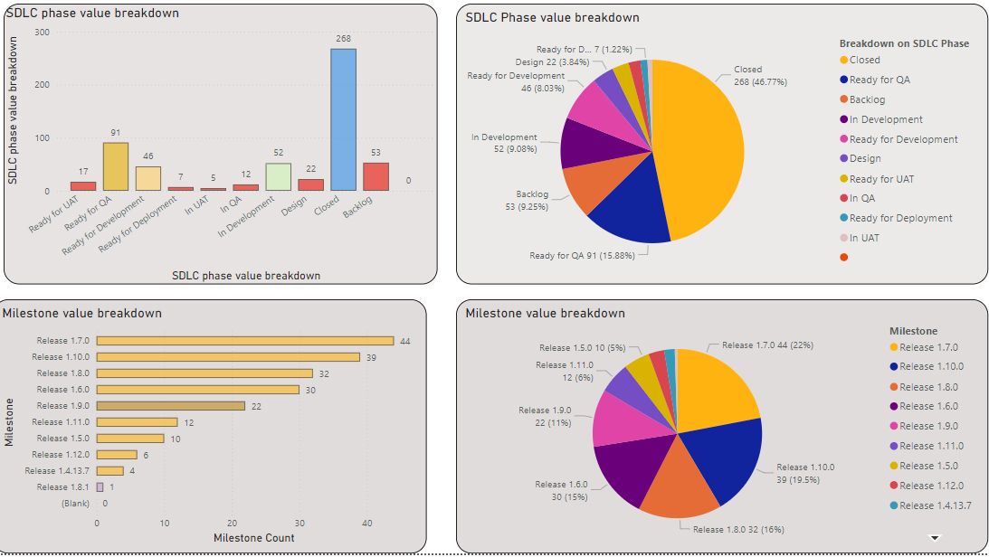
GitHub Hygiene Reports – Reports Developed in Power BI
Notes:
We will implement a feedback loop through GitHub hygiene reports to identify non-compliance and ensure adherence to standards. This initiative will enhance overall GitHub hygiene, leading to improved ease of use for the team.

Slide 12
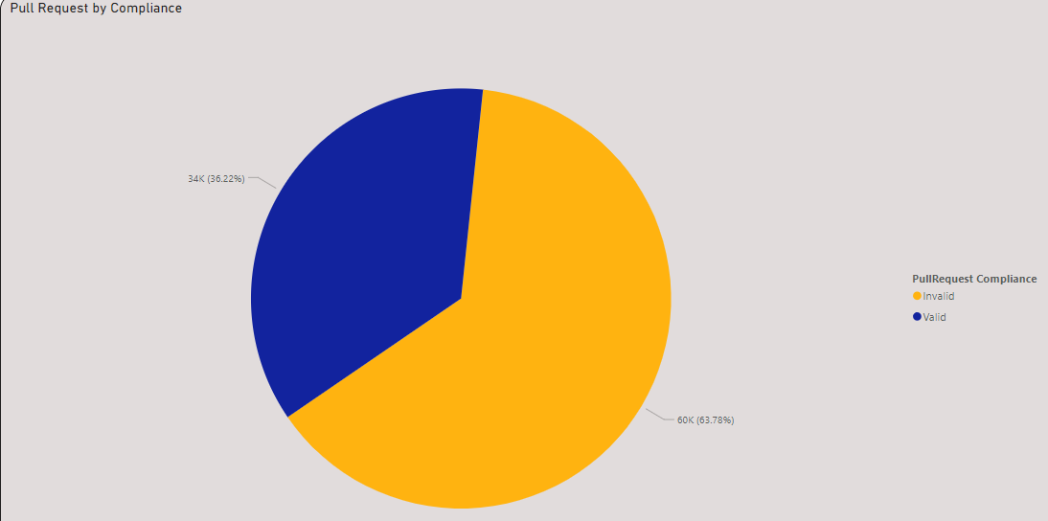
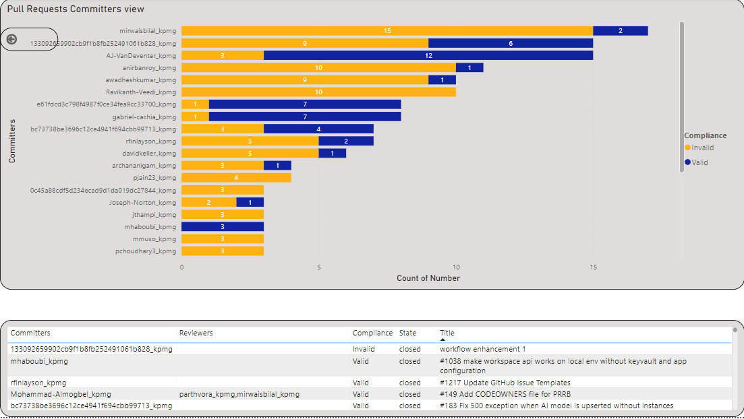
GitHub Hygiene Compliance Metrics Reports
Notes:
We will implement a feedback loop through GitHub hygiene reports to identify non-compliance and ensure adherence to standards. This initiative will enhance overall GitHub hygiene, leading to improved ease of use for the team.

Slide 13
Measure Progress: Review & Feedback
Quarterly Review on the progress
Completed items :
=> Pull data from GitHub: Issues, Pull Request and Projects related information – Completed
=> Designed and developed the first set of reports for Issues and pull requests – Completed
=> Implemented graphQL to fetch and extract project data from Git Hub - Completed
On going / In Progress :
=> Deploy the reports on workspace - IN Progress
=> Develop additional reports for drill down and executive dashboard - IN Progress
=> Near to real time data feed in the backend data source – TO DO
Approx ~ 60% Complete Planned Target : Q2 2025
Notes:
We will implement quarterly review sessions to foster a culture of excellence and continuous improvement. This will uplift team members and ensure we remain committed to meeting or exceeding customer expectations through sustained development.

Slide 14
Goal 3: Exceptional Client Experiences
Automation : By the end of Q3 FY25,
Using python with GitHub API and GraphQL, extract and build release notes based on config file
Develop and implement an automation tool to,
Build the release notes markdown file for a current release with a single click
Tagging and creating releases in GH repos
Automate the tagging and creating release for GitHub Repositories
using a set of configuration values
fetches list of repositories to be tagged and releases
Notes:
Today's agenda will cover three main themes: Uplifting our organization, Driving quality outcomes that matter for our clients, and Delivering exceptional client experiences. We will break down each theme into specific goals and processes to enhance our operations.

Slide 15

Automation : Release notes and Tagging Releases
Automation for the below items,
Generation of Release Notes
Tagging and creating release for GH repositories
Important benefits of Automation​
Automation streamlines the management of GH repositories, reducing manual errors & enhance efficiency in workflows
Utilizing automated scripts can significantly improve the release process by ensuring consistency and saving time.
Single Click Functionality : Users will be able to create release notes markdown files with a single click, enhancing efficiency
Efficiency in Tagging​ Automating the tagging process on GH streamlines workflows, saving developers valuable time and effort
Error Reduction​: Scripting the release process helps to minimize human errors, ensuring a smoother deployment experience
Improved Consistency: Automation ensures a consistent approach to managing releases, facilitating better cross collaboration
​
Notes:
By the end of Q3 FY25, we will develop an automation tool that builds release notes markdown files with a single click. This tool will fetch relevant issue items tagged to the release, simplifying release management.

Slide 16

Ready for use: Upcoming Release
These automation tool for generating release notes and Tagging, has helped streamline the process of saving time and reducing manual effort.
Generate Release Notes
The generated markdown file will include detailed release notes that reflect the status and milestones from GitHub.
Automate Tagging and creating releases
Automation script for creating tagging and creating releases for repositories in GitHub
Notes:
The automation tool will create a live markdown file containing comprehensive release notes based on the status and release milestones set in GitHub. This will ensure that our clients receive clear and up-to-date information on releases.

Slide 17
Measure Progress: Review & Feedback
Quarterly Review on progress
Completed items :
Development and testing of automation of release note – Completed
Development and testing of Automated Tagging and creating releases – Completed
Implementing config.txt and using graphQL to extend solution for upcoming releases - Completed
On going / In Progress :
Put this scripts to use and capture feedback and validate with actual releases - IN Progress
Testing the automation for edge cases and incorporating newer requirement- IN Progress
Approx ~ 60% Complete Planned Target : Q2 2025
Notes:
We will implement quarterly review sessions to foster a culture of excellence and continuous improvement. This will uplift team members and ensure we remain committed to meeting or exceeding customer expectations through sustained development.

Slide 18
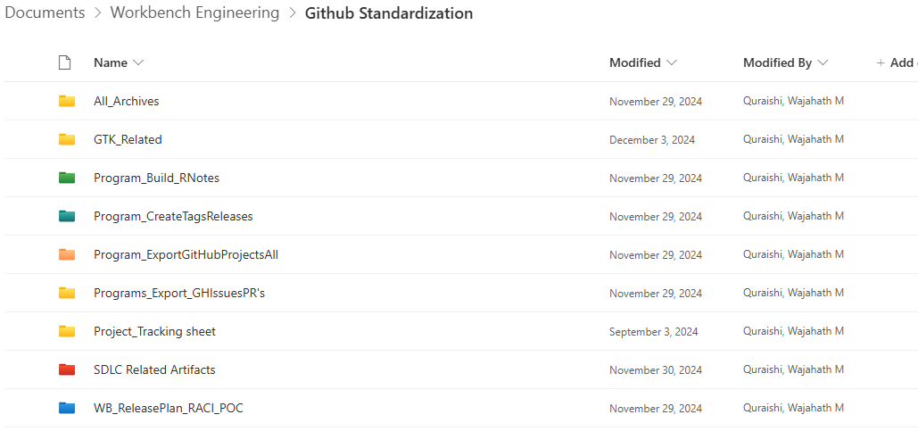
Contributions : Location for Artifacts
Notes:
In conclusion, our FY2025 goals are designed to uplift our organization, drive quality outcomes, and deliver exceptional client experiences. By focusing on these objectives, we will enhance our processes and ensure continued growth and success.

Slide 19

Conclusion
Organizational Uplift
Our goals for FY2025 aim to uplift the organization by fostering a positive work environment and enhancing team collaboration.
Quality Outcomes
We are committed to driving quality outcomes through improved processes and adherence to best practices in our operations.
Exceptional Client Experiences
Delivering exceptional client experiences is at the core of our objectives, ensuring satisfaction and long-term relationships.
Growth and Success
By focusing on our objectives, we will ensure continued growth and success in the upcoming fiscal year.
Notes:
In conclusion, our FY2025 goals are designed to uplift our organization, drive quality outcomes, and deliver exceptional client experiences. By focusing on these objectives, we will enhance our processes and ensure continued growth and success.

Slide 20

Process Development
Change Management Framework
Our goal is to adhere to the GTK change management framework to streamline Workbench deliverables and ensure consistent quality.
Cross-Functional Collaboration
Enhancing collaboration between cross-functional teams is essential for improving incident management and operational support processes.
Improving Customer Satisfaction
The ultimate goal of these initiatives is to improve customer satisfaction through effective management of incidents and support.
Notes:
As a Delivery Manager for AI Workbench, by the end of Q3 FY25, we aim to establish a mature change management framework for Workbench deliverables. This requires collaboration with cross-functional teams to enhance incident management and operation support processes, improving customer satisfaction.

Slide 21
My Goal
Goal 3: Exceptional Client Experiences
Automation : By the end of Q3 FY25,
Develop and implement an automation tool to,
Build the release notes markdown file for a current release with a single click
Tagging and creating releases in GH repos
Using python with GitHub API and GraphQL, extract and build release notes based on config file
Automate the tagging and creating release for GitHub Repositories using configuration values
The script is designed to automate the process of tagging repositories and creating releases on GitHub
Reads configuration from specified files,
fetches list of repositories applies the specified tags and releases according to the provided rules
Notes:
Today's agenda will cover three main themes: Uplifting our organization, Driving quality outcomes that matter for our clients, and Delivering exceptional client experiences. We will break down each theme into specific goals and processes to enhance our operations.

Slide 22

Goal 3: Delivering Exceptional Client Experience
Enhancing Client Experiences
Our primary focus is on enhancing client experiences through innovative automation techniques that cater to their needs.
Streamlining Processes
By streamlining processes, we can eliminate delays and ensure more efficient service delivery to our clients.
Timely High-Quality Service
Our commitment is to provide timely and high-quality service, ensuring client satisfaction and loyalty.
Notes:
The final goal theme emphasizes enhancing client experiences through automation. We aim to streamline processes to ensure that our clients receive timely and high-quality service.

